Slide 1
Environmental Station Monitoring System
Made with ThingsBoard and RIOT OS

Slide 2
Main idea
We want to monitor 2 environmental stations, each with 5 sensors:
- Temperaure (- 50 … 50 °C)
- Humidity (0 … 100 %)
- Wind Direction (0 … 360 Degrees)
- Wind Intensity (0 … 100 m/s)
- Rain Height (0 … 50 mm/h)
We send the data via MQTT-SN to a broker, which will then forward the messages to
ThingsBoard through an MQTT channel.
We visualize the data making it visible to anyone who’d like to.

Slide 3

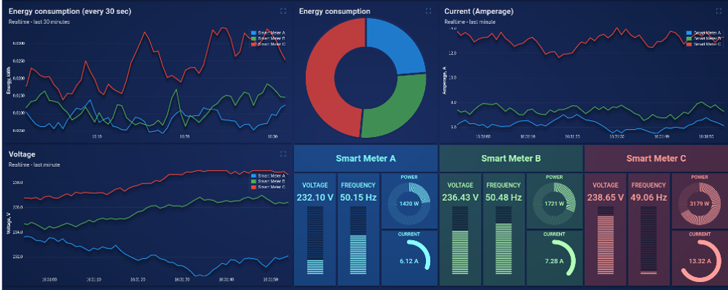

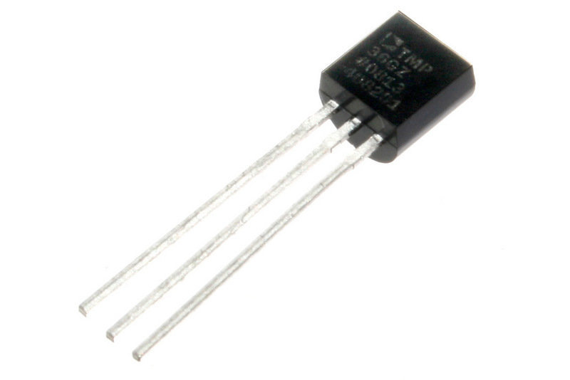


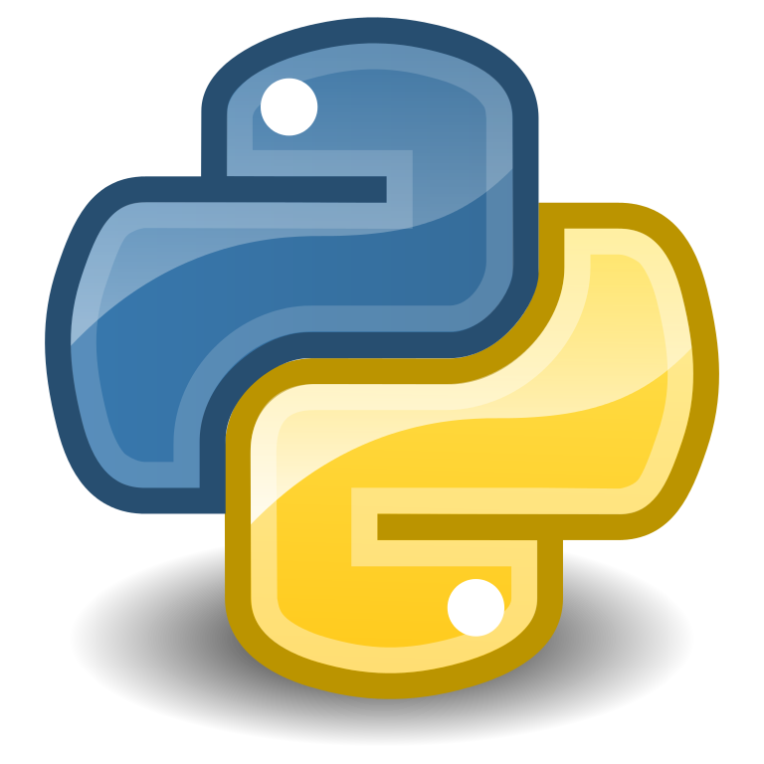
Architecture
ThingsBoard Dashboard
Environmental Station 1
ThingsBoard IoT Platform
Mosquitto broker
MQTT-SN Messages
MQTT Channel
Python Bridge
Environmental Station 2

Slide 4
Implementation
The sensors and environmental stations are simulated by a simple program done RIOT OS
The data is sent with MQTT-SN messages to the Mosquitto broker, which forwards them to a bridge made with Python.
The bridge indeed is subscribed to the topics that
represent telemetries, and sends them to ThingsBoard
through MQTT messages.
ThingsBoard IoT platform collects data through the MQTT channel (MQTT broker integrated in the platform) and shows it on its dashboard, which is public so that anyone could check it out.

Slide 5
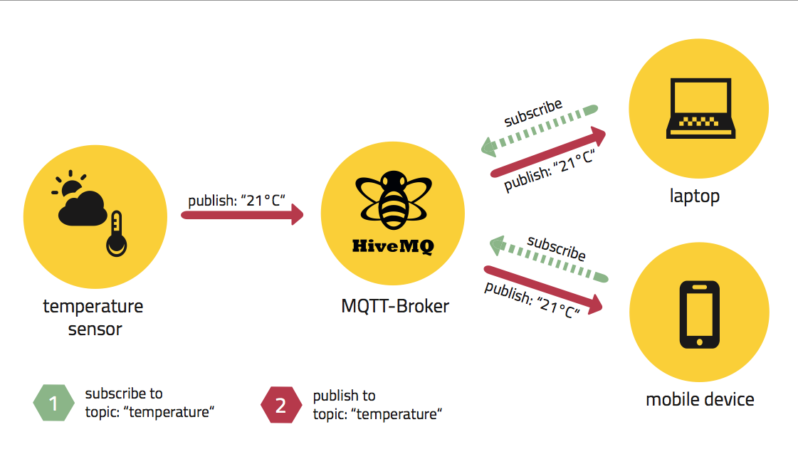
Technology: MQTT Protocol
MQTT is a machine-to-machine connectivity protocol, designed to be lightweight
and work well even in situations where little resources are provided.
Because of this, it’s ideal for sensor communication.
It’s based on the publish subscriber paradigm

Slide 6
Technology: MQTT-SN
MQTT-SN stands for MQTT for Sensor Network, and it was designed specifically for this environment. Unlike MQTT, it doesn’t rely on TCP, as it would be too much for devices with low power and little memory and computing capabilities.
Main differences in respect to MQTT:
- CONNECT message is split in 3 smaller messages, so that also the will
message is sent to broker. The will message specifies what to send in
case the device is no longer connected to the network.
- to identify the topic an ID of 2 bytes is used, instead of a string.
There are other differences but are not so relevant to us.

Slide 7

Technology: RIOT OS
RIOT OS is an open source operating
system designed for the Internet of
Things. Supports most low power devices
and microcontroller architectures
(32-bit, 16-bit and 8-bit).
It’s programmable in C and C++, uses wide spread tools such as gcc and valgrind, and it’s compliant with POSIX.
It supports most IoT standards and it’s resource friendly. When a program it’s executed usually there are two threads running: the main thread that executes the task, and the idle thread which runs when the main thread stops. The idle thread puts the device in a “sleep mode” to save energy and resources.

Slide 8
Technology: Mosquitto RSMB
Mosquitto Really Small Message Broker is a server implementation of MQTT and MQTT-SN protocols.
It was first released under IBM, and now it’s open source as an Eclipse project.

Slide 9
Technology: ThingsBoard
ThingsBoard is an open-source IoT platform to collect, process, visualize data and manage devices.
Enables connectivity through standard IoT protocols like CoAP, HTTP, MQTT and supports cloud deployment.
The pillars of this platform are scalability, fault-tolerance and performance.

Slide 10
References
RIOT OS: http://riot-os.org/
MQTT/MQTT-SN: https://mqtt.org/
Mosquitto RSMB: https://github.com/eclipse/mosquitto.rsmb
ThingsBoard: https://thingsboard.io

Slide 11
Thank you for you attention!

